Slide 1
Class of 2024
Utah College Application Week
Notes:
Introduce everyone (counselors, Natalie, College Reps, etc.)
You should have received a folder. Valuable information in it including an unofficial transcript. CLose chromebooks put folders down for now while we give you valuable information.

Slide 2
Today’s Agenda
College and Career Readiness (CCR) information.
Access Keys to Success Account for application, scholarship, and career resources.
Apply to a college and/or explore career opportunities.
Check out with volunteers and fill out a pennant!
Notes:
Make sure they know the expectation is that they stay the whole class period.

Slide 3
Be Advised
YOU are responsible for tracking and maintaining eligibility for:
Graduation
College Admission
Free Application for Federal Student Aid (FAFSA) Completion
Scholarship Applications
NCAA (if applicable)

Slide 4
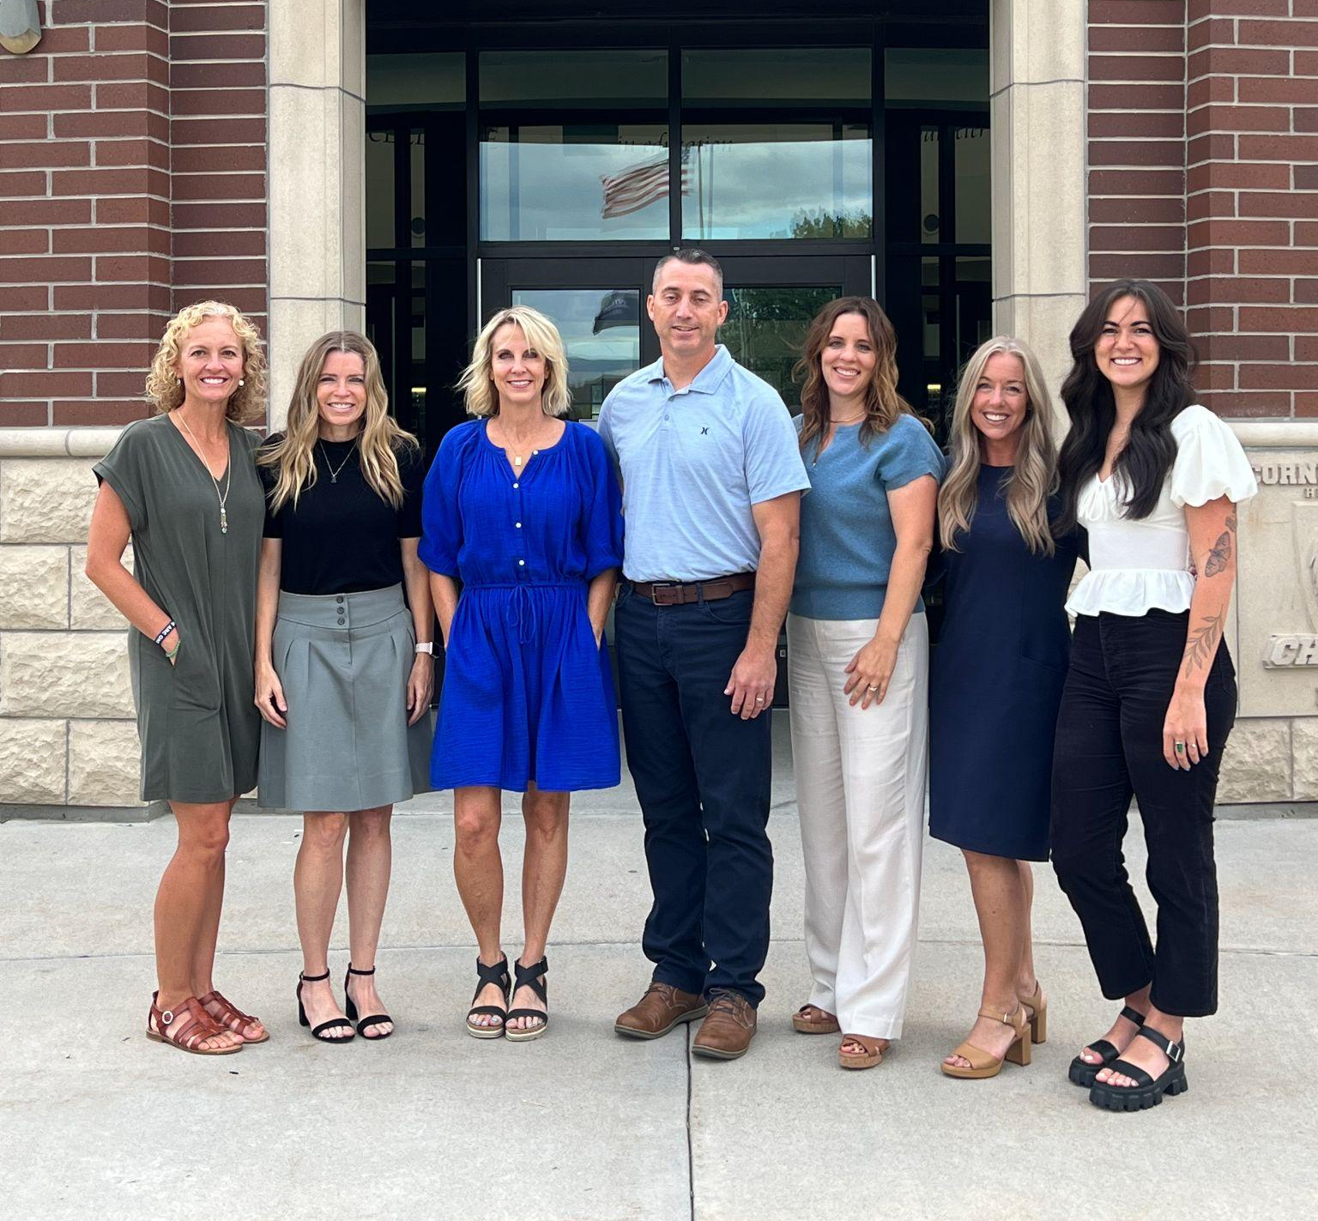
Know Your Counselor
A-Car Elizabeth Rooklidge
Cas-E Amy Hardcastle
F-Ht Sandra Steele
Hu-Mar Jenny Davis
Mas-Ph Michelle Anderson
Pi-Sp Shayla Sego
Sq-Z Phil Handley

Slide 5
Where will YOU be one year from now?
Employment
Trade/
Vocational School
Military
College/
University
Church/
Humanitarian Service
Internship/
Apprenticeship
Notes:
*Point out importance of requesting a deferment if planning on college after a mission..

Slide 6
What if I am undecided?
RESEARCH
CAREERS WHICH INTEREST YOU
Search School, Career, and Employer Websites
Attend College & Career Events, Including Tours & Open Houses
EVALUATE
Strengths
Values
Personality
Skills
YouScience is an excellent resource!
DETERMINE
THE TYPE & LEVEL OF TRAINING/SCHOOLING REQUIRED
On-the-Job Training, Apprenticeship, Diploma, Certificate, Associate Degree, Bachelor Degree, Graduate Degree
Notes:
Emphasize usefulness of YouScience, especially if undecided about career.

Slide 7
If you are applying for any type of educational program –
college, technical school,
trade program, etc. –
KNOW THE APPLICATION
DEADLINES & REQUIREMENTS.
*Always use your personal email address
(not your csddocs account) for applications to keep
receiving communications after graduation.

Slide 8
Monitor College Application Deadlines
Priority vs. Final Deadline
Letters of Recommendation
Transcript Request–Parchment.com
ACT Scores
* Follow instructions specific to your college!

Slide 9
Complete the FAFSA
FAFSA Night!
Tuesday, January 9th
6:00 PM
Atrium
See flyer for a list
of what to bring!
Some scholarships require the FAFSA (including the Opportunity Scholarship)
FAFSA application will be available in December at www.fafsa.gov

Slide 10
Take Advantage of Scholarship Opportunities
COLLEGE/UNIVERSITY
Merit Based
Need Based
Program/Department
. . . and more!
WHERE?
Individual College Websites
STATE/LOCAL
Opportunity Scholarship
Utah Promise
Dreamers
. . . and more!
WHERE?
ktsutah.org/resources
PRIVATE
Private Businesses
Foundations
Leadership Organizations
WHERE? Student Center Website, “Pay for College” then “Scholarships”
Notes:
Every year thousands of dollars in scholarship money goes unclaimed ...
Three main categories of scholarships and where to find them:
College/University Specific Scholarships - Often “non-competitive” - all who meet criteria and application deadline will be awarded. Found on individual college websites. A good place to start!
State/Local Scholarships - Also often non-competitive. Regents/Opportunity Scholarship is one example. Must meet criteria and application deadlines. Links at Ktsutah.org/resources.
Private Scholarships - Various requirements. Can be more competitive, recipients often chosen by selection committee. Visit student center website for a list by month. Updated frequently, so check back often.
Know that colleges, state/local agencies, and private business DO NOT accommodate late applications.
The payoff is worth the time/effort, so do your research and apply!

Slide 11
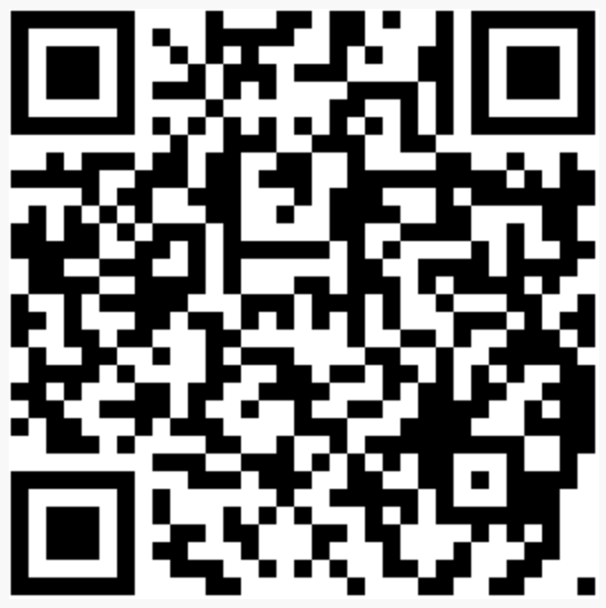
UTILIZE RESOURCES !
The Student Center Website for information on graduation requirements, careers, college, scholarships, senior awards, and much more.
https://ccstudentcenter.weebly.com
Our College Resource Advisor,
Stephanie Rowan-Bailey.
Notes:
SC website available 24/7

Slide 12
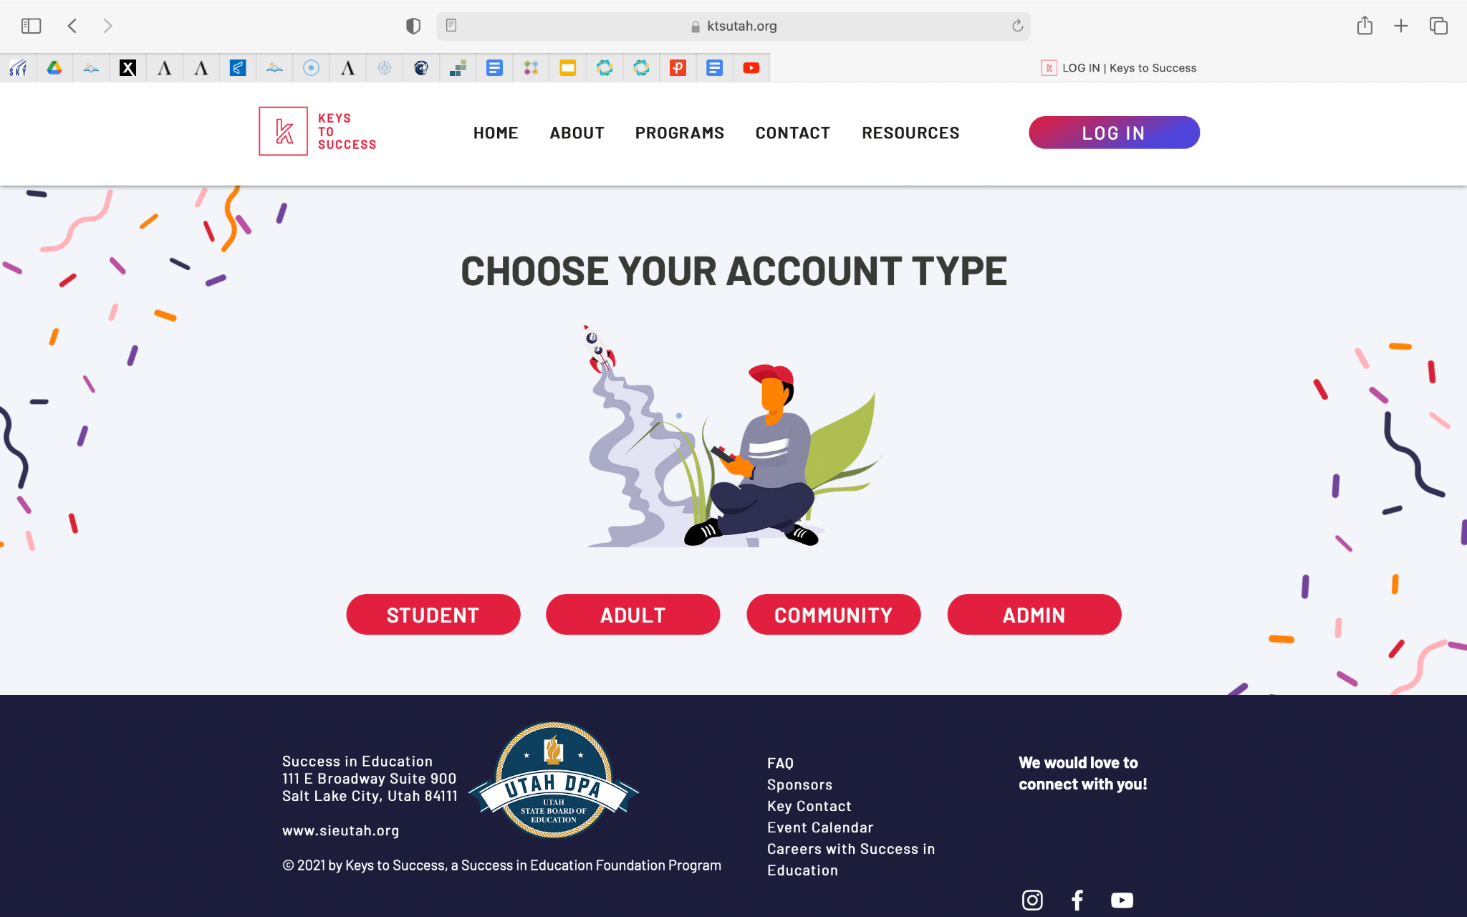
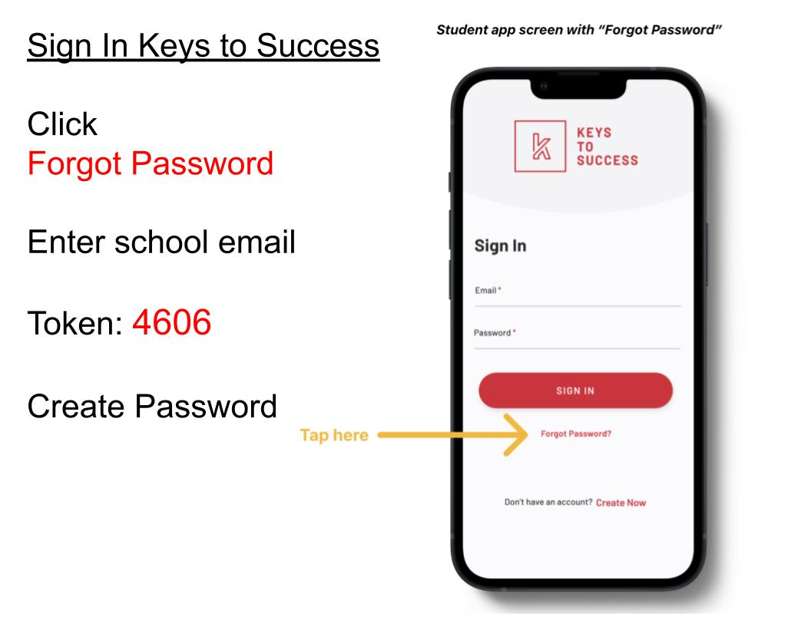
Access Keys to Success Account
www.ktsutah.org
Notes:
While folders are being handed out go over what is in them. Hand out folders. KTS is an organizational tool to help keep everything organized! Give students a few min. To login. Walk around room

Slide 13
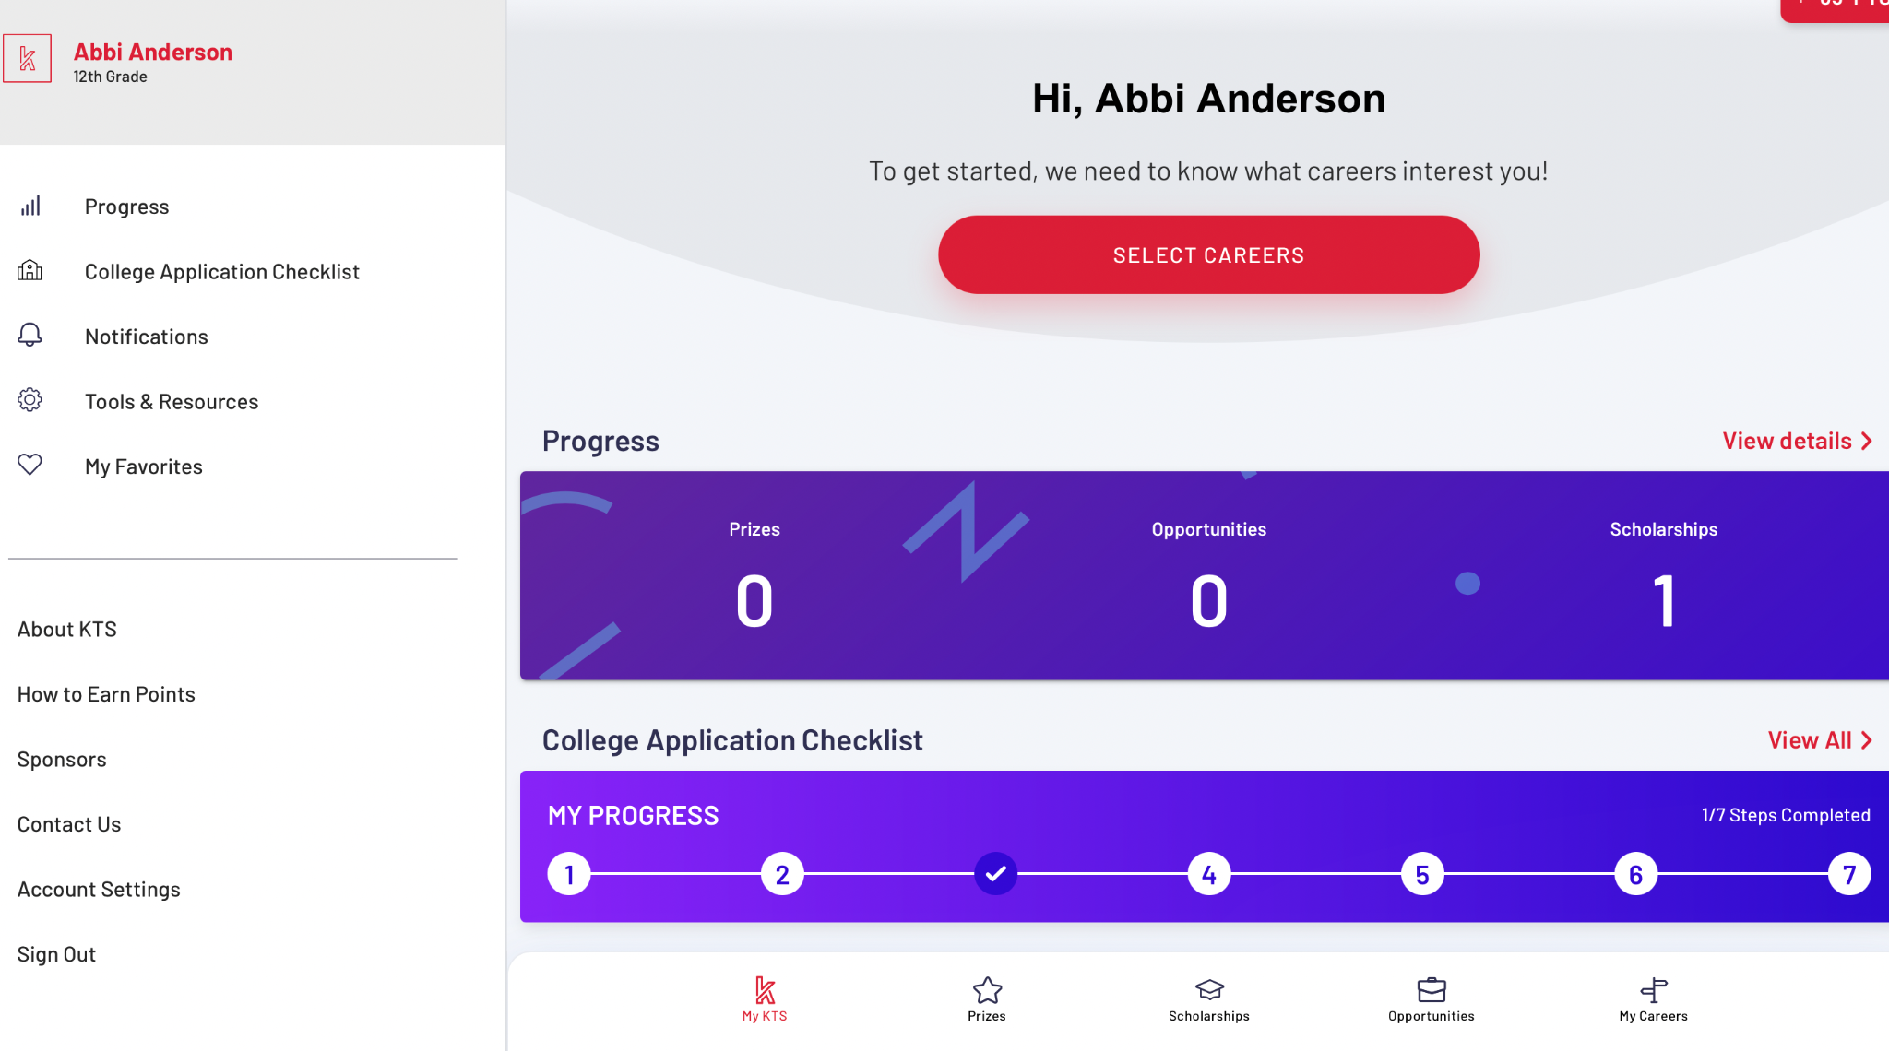
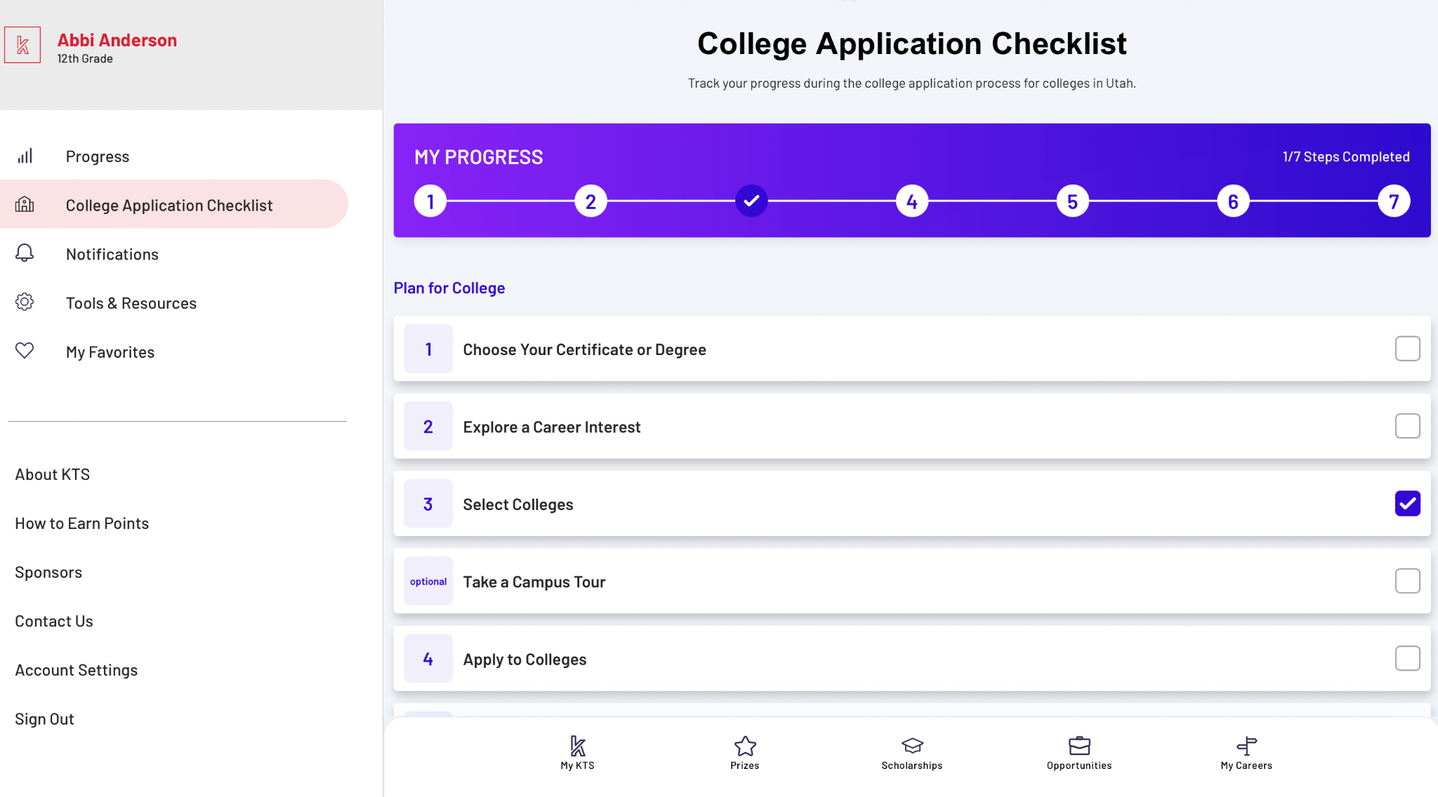
Once logged in your screen should look like this
Click on College Application Checklist
Click on #3 Select Colleges (You can use Map View or List View)
Select colleges you want to apply to
Return to College APplication Checklist
Click on #4. Apply to College!!!
Notes:
Walk around the room to help students get to these screens.

Slide 14
Download
the APP

Slide 15
Things I can be working on…
Keys to Success: College Application Checklist
Complete College applications
Talk with college representatives
Create a Parchment Account (transcript requests)
Create FSA ID (for FAFSA application)
Search for Scholarships
Career Assessments (YouScience and/or Keys to Success)
Notes:
Make sure they know the expectation is that they stay the whole class period.

Slide 16
Before you go…
Please check out with our incredible parent volunteers, fill out a college pennant, and grab some swag!
BEST OF LUCK CLASS OF 2024!

